Slide 1
Level 1 Chapter 3: Data Storage Solutions

Slide 2
Introduction to Database Services
Azure supports multiple database services, enabling you to run popular relational database management systems, such as SQL Server, PostgreSQL, and MySQL, in the cloud.
Most Azure database services are fully managed, freeing up valuable time you’d otherwise spend managing your database. Enterprise-grade performance with built-in high availability means you can scale quickly and reach global distribution without worrying about costly downtime.
Developers can take advantage of industry-leading innovations such as built-in security with automatic monitoring and threat detection, automatic tuning for improved performance.

Slide 3
Describe Azure services for open-source databases
In addition to Azure SQL services, Azure data services are available for other popular relational database systems, including MySQL, MariaDB, and PostgreSQL.
The primary reason for these services is to enable organizations that use them in on-premises apps to move to Azure quickly, without making significant changes to their applications.

Slide 4
What are MySQL, MariaDB, and PostgreSQL?
MySQL, MariaDB, and PostgreSQL are relational database management systems that are tailored for different specializations.
MySQL started life as a simple-to-use open-source database management system. It's the leading open source relational database for Linux, Apache, MySQL, and PHP (LAMP) stack apps. It's available in several editions; Community, Standard, and Enterprise. The Community edition is available free-of-charge, and has historically been popular as a database management system for web applications, running under Linux.
Versions are also available for Windows. Standard edition offers higher performance, and uses a different technology for storing data. Enterprise edition provides a comprehensive set of tools and features, including enhanced security, availability, and scalability. The Standard and Enterprise editions are the versions most frequently used by commercial organizations, although these versions of the software aren't free.

Slide 5
Identify data formats
Data is a collection of facts such as numbers, descriptions, and observations used to record information.
Data structures in which this data is organized often represents entities that are important to an organization (such as customers, products, sales orders, and so on).
Each entity typically has one or more attributes, or characteristics (for example, a customer might have a name, an address, a phone number, and so on).

Slide 6
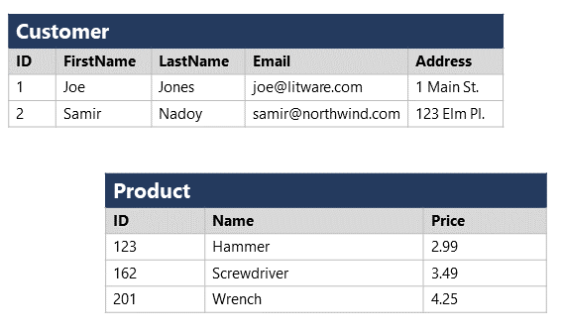
Structured data
Structured data is data that adheres to a fixed schema, so all of the data has the same fields or properties.
Most commonly, the schema for structured data entities is tabular - in other words, the data is represented in one or more tables that consist of rows to represent each instance of a data entity, and columns to represent attributes of the entity.
For example, the following image shows tabular data representations for Customer and Product entities.

Slide 7
Semi-structured data
// Customer 1
{
"firstName": "Joe",
"lastName": "Jones",
"address":
{
"streetAddress": "1 Main St.",
"city": "New York",
"state": "NY",
"postalCode": "10099"
},
"contact":
[
{
"type": "home",
"number": "555 123-1234"
},
{
"type": "email",
"address": "joe@litware.com"
}
]
}
// Customer 2
{
"firstName": "Samir",
"lastName": "Nadoy",
"address":
{
"streetAddress": "123 Elm Pl.",
"unit": "500",
"city": "Seattle",
"state": "WA",
"postalCode": "98999"
},
"contact":
[
{
"type": "email",
"address": "samir@northwind.com"
}
]
}
Semi-structured data is information that has some structure, but which allows for some variation between entity instances. For example, while most customers may have an email address, some might have multiple email addresses, and some might have none at all.
One common format for semi-structured data is JavaScript Object Notation (JSON). The example below shows a pair of JSON documents that represent customer information. Each customer document includes address and contact information, but the specific fields vary between customers.

Slide 8
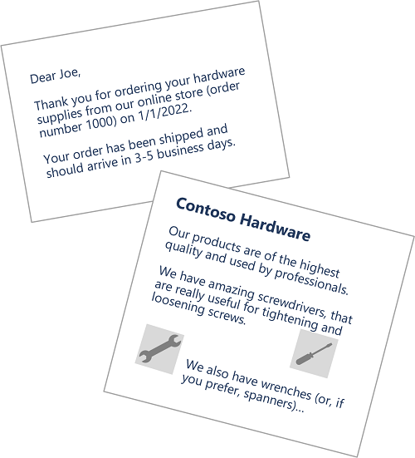
Unstructured data
Not all data is structured or even semi-structured. For example, documents, images, audio and video data, and binary files might not have a specific structure. This kind of data is referred to as unstructured data.

Slide 9
Explore file storage
The ability to store data in files is a core element of any computing system. Files can be stored in local file systems on the hard disk of your personal computer, and on removable media such as USB drives; but in most organizations, important data files are stored centrally in some kind of shared file storage system. Increasingly, that central storage location is hosted in the cloud, enabling cost-effective, secure, and reliable storage for large volumes of data.
The specific file format used to store data depends on a number of factors, including:
The type of data being stored (structured, semi-structured, or unstructured).
The applications and services that will need to read, write, and process the data.
The need for the data files to be readable by humans, or optimized for efficient storage and processing.

Slide 10
Delimited text files
Data is often stored in plain text format with specific field delimiters and row terminators. The most common format for delimited data is comma-separated values (CSV) in which fields are separated by commas, and rows are terminated by a carriage return / new line. Optionally, the first line may include the field names. Other common formats include tab-separated values (TSV) and space-delimited (in which tabs or spaces are used to separate fields), and fixed-width data in which each field is allocated a fixed number of characters. Delimited text is a good choice for structured data that needs to be accessed by a wide range of applications and services in a human-readable format.
FirstName,LastName,Email
Joe,Jones,joe@litware.com
Samir,Nadoy,samir@northwind.com

Slide 11
JavaScript Object Notation (JSON)
{
"customers":
[
{
"firstName": "Joe",
"lastName": "Jones",
"contact":
[
{
"type": "home",
"number": "555 123-1234"
},
{
"type": "email",
"address": "joe@litware.com"
}
]
},
{
"firstName": "Samir",
"lastName": "Nadoy",
"contact":
[
{
"type": "email",
"address": "samir@northwind.com"
}
]
}
]
}
JSON is a ubiquitous format in which a hierarchical document schema is used to define data entities (objects) that have multiple attributes. Each attribute might be an object (or a collection of objects); making JSON a flexible format that's good for both structured and semi-structured data.
The following example shows a JSON document containing a collection of customers. Each customer has three attributes (firstName, lastName, and contact), and the contact attribute contains a collection of objects that represent one or more contact methods (email or phone). Note that objects are enclosed in braces ({..}) and collections are enclosed in square brackets ([..]). Attributes are represented by name : value pairs and separated by commas (,).

Slide 12
Extensible Markup Language (XML)
XML is a human-readable data format that was popular in the 1990s and 2000s. It's largely been superseded by the less verbose JSON format, but there are still some systems that use XML to represent data. XML uses tags enclosed in angle-brackets (<../>) to define elements and attributes, as shown in this example:
<Customers>
<Customer name="Joe" lastName="Jones">
<ContactDetails>
<Contact type="home" number="555 123-1234"/>
<Contact type="email" address="joe@litware.com"/>
</ContactDetails>
</Customer>
<Customer name="Samir" lastName="Nadoy">
<ContactDetails>
<Contact type="email" address="samir@northwind.com"/>
</ContactDetails>
</Customer>
</Customers>

Slide 13
Binary Large Object (BLOB)
Ultimately, all files are stored as binary data (1's and 0's), but in the human-readable formats discussed above, the bytes of binary data are mapped to printable characters (typically through a character encoding scheme such as ASCII or Unicode). Some file formats however, particularly for unstructured data, store the data as raw binary that must be interpreted by applications and rendered. Common types of data stored as binary include images, video, audio, and application-specific documents.
When working with data like this, data professionals often refer to the data files as BLOBs (Binary Large Objects).

Slide 14
Optimized file formats
While human-readable formats for structured and semi-structured data can be useful, they're typically not optimized for storage space or processing. Over time, some specialized file formats that enable compression, indexing, and efficient storage and processing have been developed.
Some common optimized file formats you might see include Avro, ORC, and Parquet:

Slide 15
Optimized file formats
Avro is a row-based format. It was created by Apache. Each record contains a header that describes the structure of the data in the record. This header is stored as JSON. The data is stored as binary information. An application uses the information in the header to parse the binary data and extract the fields it contains. Avro is a good format for compressing data and minimizing storage and network bandwidth requirements.

Slide 16
Optimized file formats
ORC (Optimized Row Columnar format) organizes data into columns rather than rows. It was developed by HortonWorks for optimizing read and write operations in Apache Hive (Hive is a data warehouse system that supports fast data summarization and querying over large datasets). An ORC file contains stripes of data. Each stripe holds the data for a column or set of columns. A stripe contains an index into the rows in the stripe, the data for each row, and a footer that holds statistical information (count, sum, max, min, and so on) for each column.

Slide 17
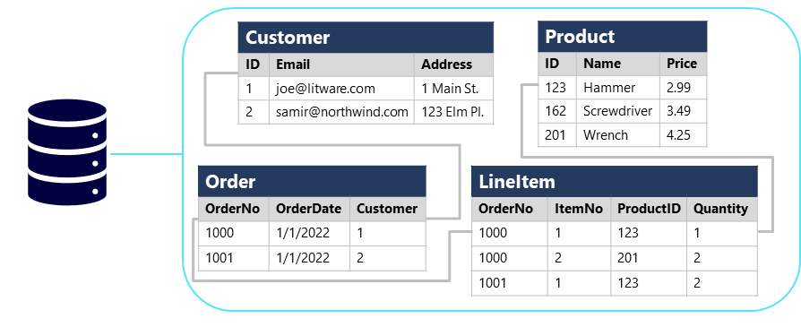
Relational databases

Slide 18
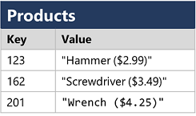
Non-relational databases
Non-relational databases are data management systems that don’t apply a relational schema to the data. Non-relational databases are often referred to as NoSQL database, even though some support a variant of the SQL language.
There are four common types of Non-relational database commonly in use.
Key-value databases in which each record consists of a unique key and an associated value, which can be in any format.

Slide 19
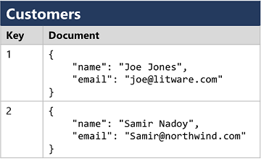
Non-relational databases
Document databases, which are a specific form of key-value database in which the value is a JSON document (which the system is optimized to parse and query)

Slide 20
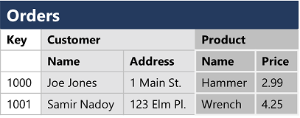
Non-relational databases
Column family databases, which store tabular data comprising rows and columns, but you can divide the columns into groups known as column-families. Each column family holds a set of columns that are logically related together.

Slide 21
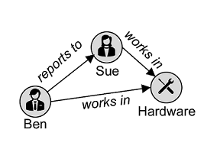
Non-relational databases
Graph databases, which store entities as nodes with links to define relationships between them.

Slide 22
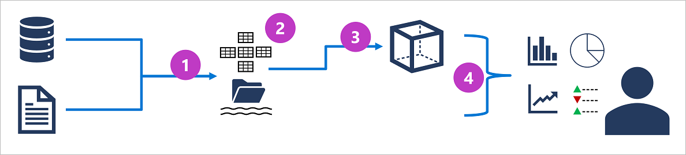
Explore analytical data processing
Analytical data processing typically uses read-only (or read-mostly) systems that store vast volumes of historical data or business metrics. Analytics can be based on a snapshot of the data at a given point in time, or a series of snapshots.
The specific details for an analytical processing system can vary between solutions, but a common architecture for enterprise-scale analytics looks like this:

Slide 23
Design a data warehouse schema
Like all relational databases, a data warehouse contains tables in which the data you want to analyze is stored. Most commonly, these tables are organized in a schema that is optimized for multidimensional modeling, in which numerical measures associated with events known as facts can be aggregated by the attributes of associated entities across multiple dimensions. For example, measures associated with a sales order (such as the amount paid or the quantity of items ordered) can be aggregated by attributes of the date on which the sale occurred, the customer, the store, and so on.

Slide 24
Tables in a data warehouse
A common pattern for relational data warehouses is to define a schema that includes two kinds of table: dimension tables and fact tables.

Slide 25
Tables in a data warehouse: Dimension tables
Dimension tables describe business entities, such as products, people, places, and dates. Dimension tables contain columns for attributes of an entity. For example, a customer entity might have a first name, a last name, an email address, and a postal address (which might consist of a street address, a city, a postal code, and a country or region). In addition to attribute columns, a dimension table contains a unique key column that uniquely identifies each row in the table. In fact, it's common for a dimension table to include two key columns:
a surrogate key that is specific to the data warehouse and uniquely identifies each row in the dimension table in the data warehouse - usually an incrementing integer number.
An alternate key, often a natural or business key that is used to identify a specific instance of an entity in the transactional source system from which the entity record originated - such as a product code or a customer ID.

Slide 26
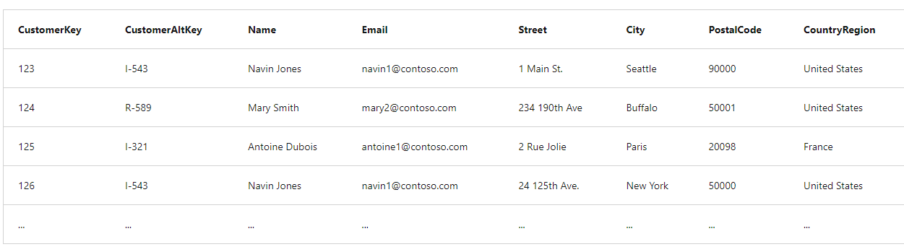
Tables in a data warehouse: Dimension tables

Slide 27
Tables in a data warehouse: Fact tables
Fact tables store details of observations or events; for example, sales orders, stock balances, exchange rates, or recorded temperatures. A fact table contains columns for numeric values that can be aggregated by dimensions. In addition to the numeric columns, a fact table contains key columns that reference unique keys in related dimension tables.
For example, a fact table containing details of sales orders might contain the following data:

Slide 28
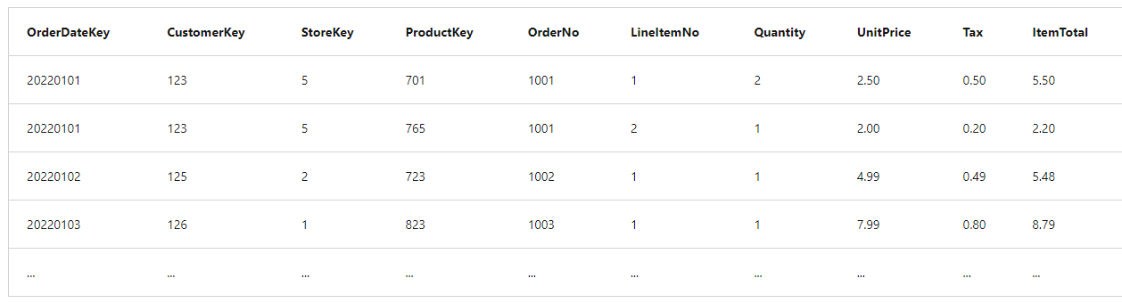
Tables in a data warehouse: Fact tables

Slide 29
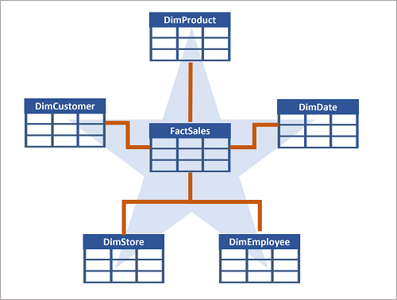
Data warehouse schema designs

Slide 30
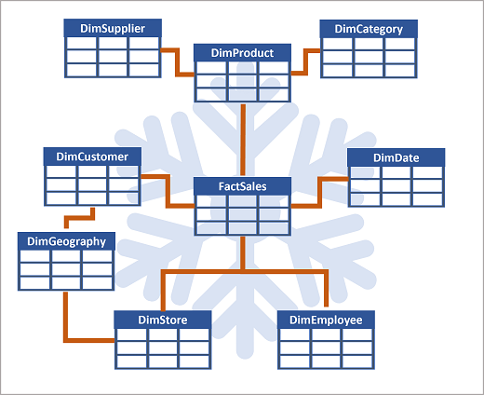
Data warehouse schema designs

Slide 31
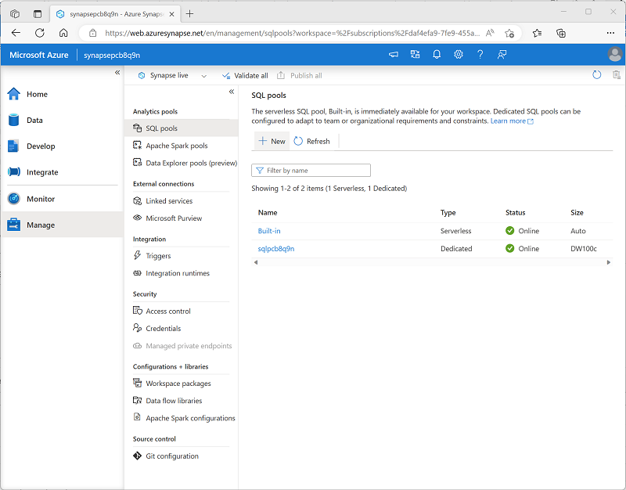
Create data warehouse tables

Slide 32
Thanking you !!!
Any Question !!!!

